Slide 1
Simple Diffuse Double Layer

Slide 2
Double layer theory
When a polarizable electrode is held at a certain voltage compared to a reference, it will have a corresponding net surface charge density.
This charge attracts or repels ions in the neighboring solution, depending on their charge.
At equilibrium, there is a layer of space charge density adjacent to the electrode due to unequal amounts of different types of ions.
The charge in solution is equal and opposite to the charge on the electrode: “double layer”.
electrode
electrolyte
double layer
(space charge)
bulk solution
(electroneutral)
charge = +Q
charge = -Q
charge = 0
Simplified schematic of the double layer.

Slide 3
Electrostatics
The electric field obeys Gauss’s law.
assume that solvent permittivity is unaffected by ion density (dilute solution).
assume that only dissolved ions contribute to the space charge density in solution.
E = electric field (V/m)
ρ = space charge density (C/m³)
ε_{soln} = solvent dielectric constant
ε₀ = vacuum permittivity
F = Faraday constant (= absolute charge on one mole of electrons)
z_{i} = charge number of ion i
c_{i} = concentration of ion i (mol/m³)

Slide 4
Dilute species transport
Dilute species (low concentration) obey the Nernst-Planck equations for mass transport.
flux includes diffusion and migration terms
assume no reactions in solution (no source term)
N_{i} = molar flux of ion i (mol/(m²*s))
D_{i} = diffusion coefficient of ion i (m²/s)
u_{i} = electrical mobility of ion i (m²/s/V)
R = gas constant
T = temperature (K)

Slide 5
Nernst-Planck-Poisson equations
Combine the equations at steady-state.
Nernst-Planck-Poisson (or Poisson-Nernst-Planck) equations
describes charge and mass distribution in dilute electrolyte.
for n ions, gives (n+1) equations in (n+1) unknowns:
n ion concentrations
electric potential (φ)

Slide 6
Gouy-Chapman theory
Solve Nernst-Planck-Poisson equations at steady-state to find double layer structure.
Specify a charge density or fixed potential at the electrode surface.
Set electroneutral bulk concentrations and zero electrical potential at large distance.
Key prediction of Gouy-Chapman theory:
extent of the double layer (region of space charge density) is of the order of the Debye length x_{D}.

Slide 7
Stern modification (GCS theory)
Account for potential drop across the region from the metal surface to the centre line of the closest approach of an ion.
This line is called the outer Helmholtz plane (OHP).
Region outside the OHP is the “diffuse double layer” where there is space charge due to ion excess / depletion.
Region inside the OHP is the “compact double layer” or “Stern layer” where the electric field is near-constant.
Treat the solvent inside the OHP as a classical rectilinear dielectric of fixed length (x_{S}), usually < 1 nm.

Slide 8
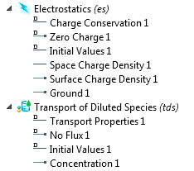
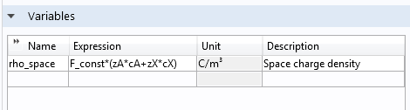
Setup (interfaces and domains)
Couple Electrostatics with Transport of Diluted Species.
Solve for as many concentrations as there are ions.
Add a Space Charge Density to electrostatics according to the ion concentrations.

Slide 9
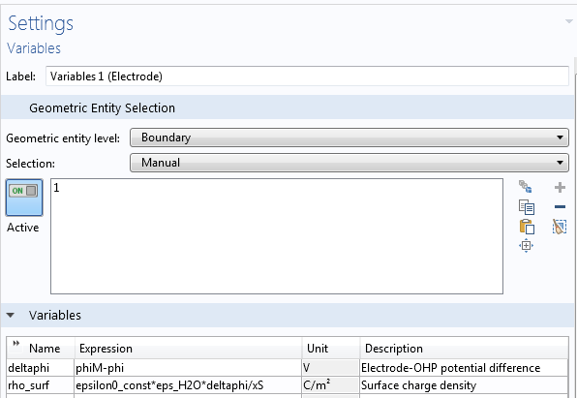
Setup (electrode boundary)
Electrode:
Set a Surface Charge Density in Electrostatics.
The surface charge density is a function of the applied voltage and the local electric potential according to the Stern expression.
Set No Flux of ions (no electrode reaction).

Slide 10
Setup (bulk boundary)
Bulk:
Set Ground in Electrostatics.
Bulk boundary must be several Debye lengths from the surface in order that the electric field tends to zero here.
Set Concentration condition to define bulk ion concentrations.
Bulk ion concentrations must be defined to give a neutral solution.

Slide 11
Results
Parametric sweep on voltage vs potential of zero charge (PZC) of the working electrode, from 1 to 10 mV.
Potential and concentration profiles for the double layer.
Output “rho_surf” to find surface charge.

Slide 12
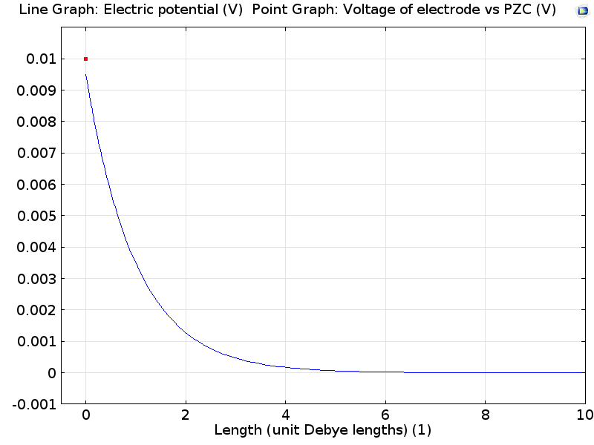
Electric potential (φ_{M} = 10 mV)
Electric potential plot showing:
potential drop in the Stern layer (a few %)
finite extent of the diffuse double layer, over a few Debye lengths.

Slide 13
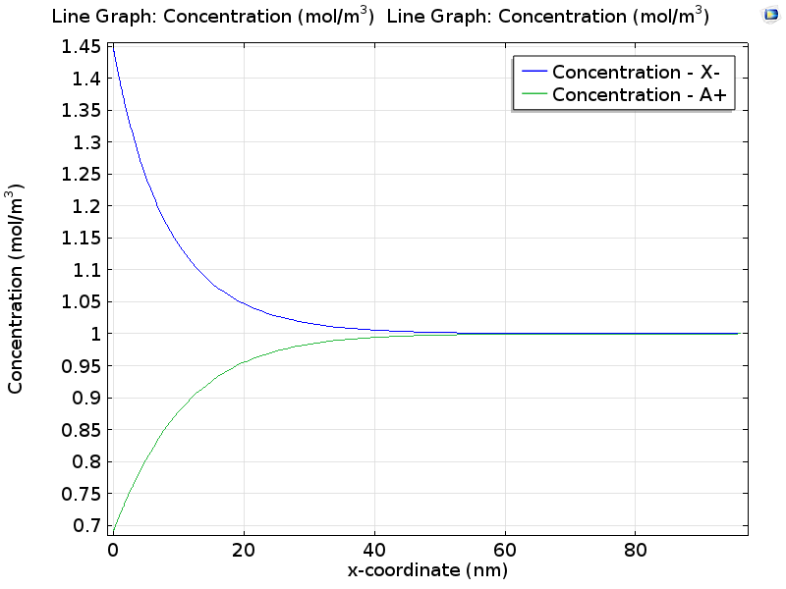
Concentrations (φ_{M} = 10 mV)
Concentration profile showing:
depletion of cations and excess of anions at a positively charged surface
nanometer extent of the diffuse double layer.

Slide 14
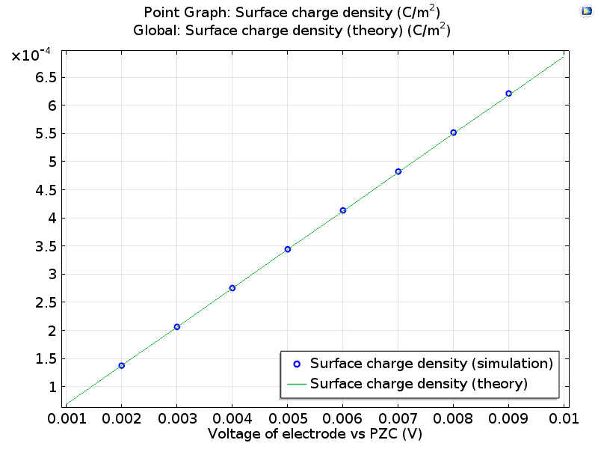
Surface charge density
Relation of double layer voltage to charge.
The derivative of this plot gives the “differential capacitance” of the electrode.
For low voltages vs PZC, GCS theory gives:
Note the small positive deviation at higher voltage where the “low voltage” linearization is less accurate.
There is a general exact solution (at higher potential) but it is more verbose!
(A is electrode area)

Slide 15
References and further reading
Original papers:
L.G. Gouy, C. R. Hebd. Séances Acad. Sci., 1909, 149, 654–657.
D.L. Chapman, Philos. Mag., 1913, 25, 475–481.
O. Stern, Z. Elektrochem., 1924, 30, 508–516.
Reference works:
Chapter 7: “Structure of the Electrical Double Layer” in J. Newman and K.E. Thomas-Alyea, Electrochemical Systems, 3rd ed., 2004, Wiley.
Chapter 13: “Double-Layer Structure and Adsorption” in Electrochemical Methods: Fundamentals and Applications, 2nd ed., 2001, Wiley.

